Slide 1
Realizing Model Simplifications with
QVT Operational Mappings

Slide 2
Agenda
Introduction
General Approach
A Transformation Example
Derivation of a Common Base Transformation
Exemplary Transformation Patterns
Conclusion

Slide 3
1. Introduction
Motivation and Objectives
Motivation
  Modeling languages can be classified into textual and graphical languages.
  Also hybrid approaches using both modeling kinds exist.
  The Specification and Description Language (SDL) is such a hybrid modeling language
  After parsing the textual input, further processing steps, such as model simplifications, are required.
  In some situations, access to an already existing model is necessary.
  The presented approach is used within the SU-MoVal framework
  http://www.su-moval.org
Objective
  Approach for model simplifications utilizing the Operational Mappings part of the Query/View/Transformation (QVT) specification.
  It should be avoided to specify an entire rewrite system manually.

Slide 4

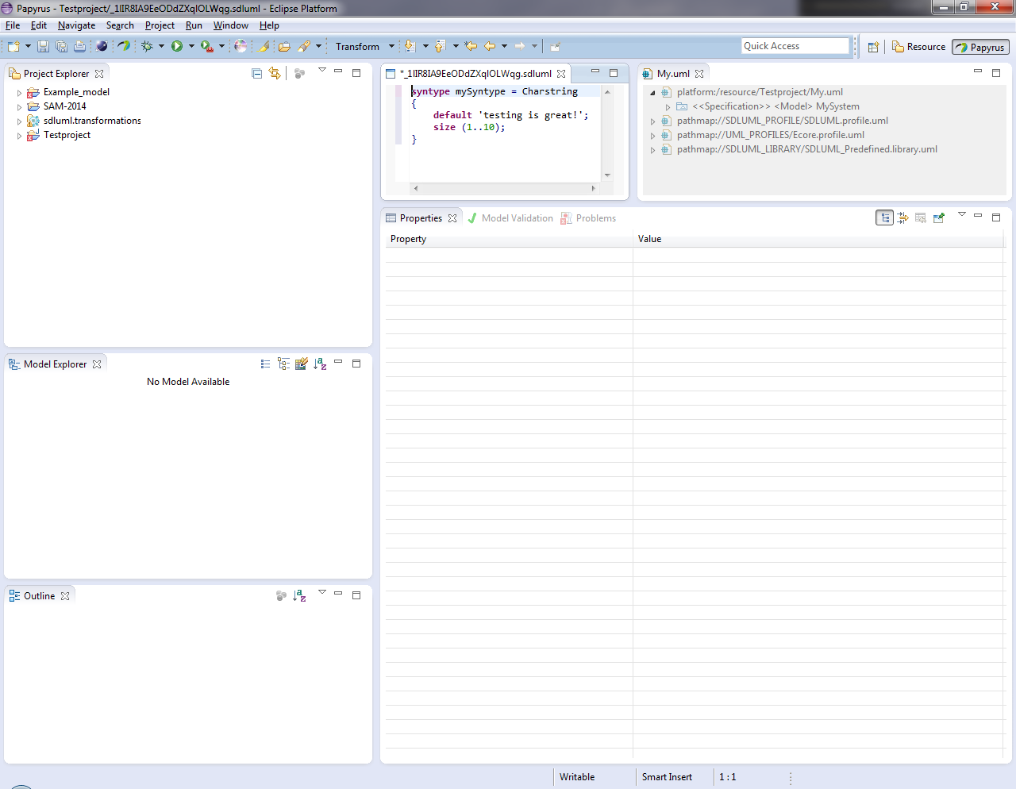
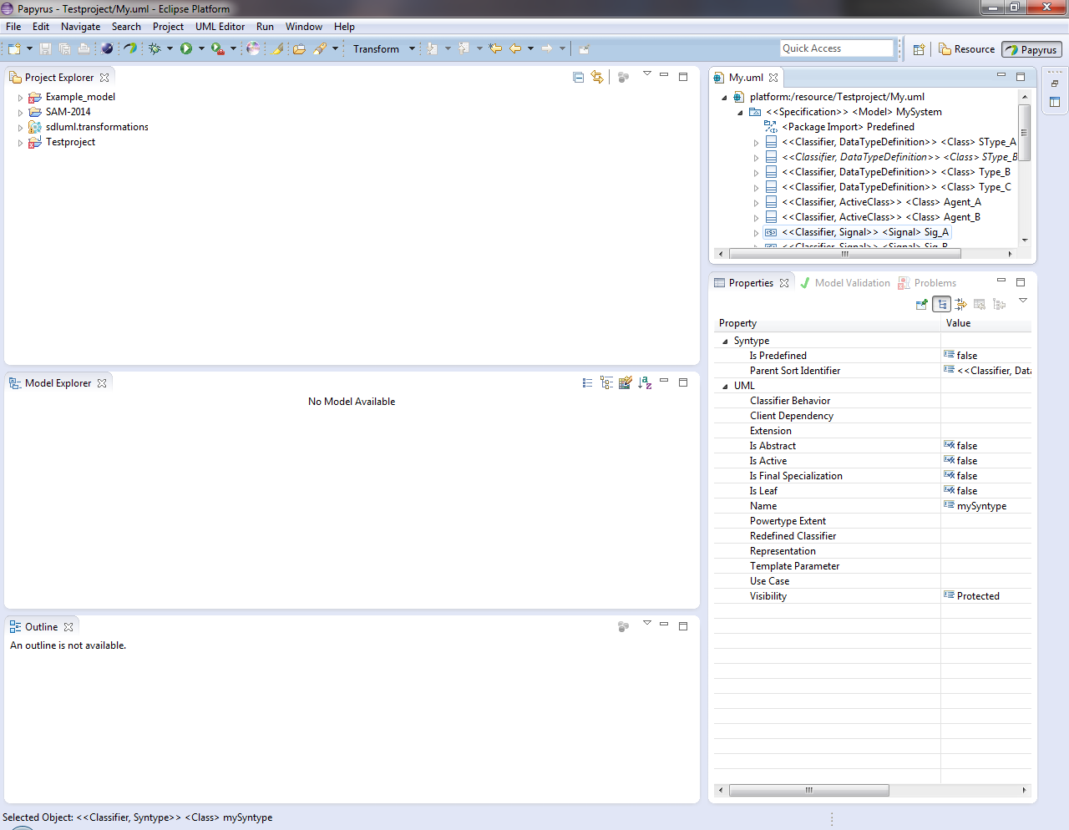


1. Introduction
The SU-MoVal framework
Textual Notation Editor
OCL Validation
Spoofax
UML Tree Editor
Model
Repository
QVTo
Transformations
Graphical UML Editor

Slide 5
2. General Approach
Derivation of a common base transformation from a metamodel of the language.
Transformations that implement a pattern for model simplification extend the derived base transformation.
The control flow of the transformation has to be redirected in an appropriate manner by superimposition of mapping operations.

Slide 6
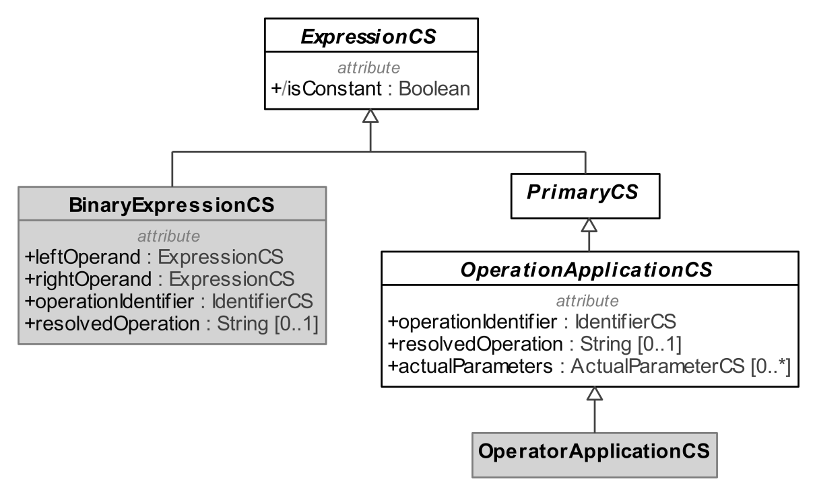
3. A Transformation Example
Metamodel for the Concrete Syntax of SDL
The concrete syntax of SDL is represented in terms of a metamodel.
The BinaryExpressionsCS metaclass is used to represent infix operation calls, e.g. 1+1.
Invocations of static operators of a data type are represented by OperatorApplicationCS.

Slide 7


4. Derivation of a Common Base Transformation
Mapping Operations for Metaclasses
Mapping of abstract metaclasses
mapping CS::ExpressionCS::mapExpressionCS() : CS::ExpressionCS
disjuncts
  CS::EqualityExpressionCS::mapEqualityExpressionCS,
  CS::PrimaryCS::mapPrimaryCS,
  …
  CS::BinaryExpressionCS::mapBinaryExpressionCS { }
Mapping of non-abstract metaclasses
mapping CS::BinaryExpressionCS::mapBinaryExpressionCS()
: CS::BinaryExpressionCS {
  result.resolvedOperation := self.resolvedOperation;
  result.operationIdentifier := self.operationIdentifier.map
  mapIdentifierCS();
  … }

Slide 8
4. Derivation of a Common Base Transformation
Processing of Metaclass Attributes
Single value property:
result.property_A := self.property_A.map mapMySubclassA();
Multi value property:
result.property_B += self. property_B->map mapMySubclassA();
Single value property with simple or enumerated type:
result. property_C := self. property_C;
Multi value property with simple or enumerated type:
result. property_D += self. property_D;
MetaClass_A
+Property_A : MySubclaasA[0..1]
+Property_B : MySubclaasA[0..*]
+Property_C : String[1]
+Property_D : String[0..*]
Notes:
Simple assignment / composite assignment operator

Slide 9
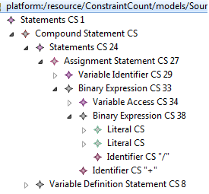
5. Exemplary Transformation Patterns
General aspects
Parsed textual notation is represented as a tree structure.
Binary expressions are simplified to operator applications in different variations.
varA = varB + 10/2

Slide 10
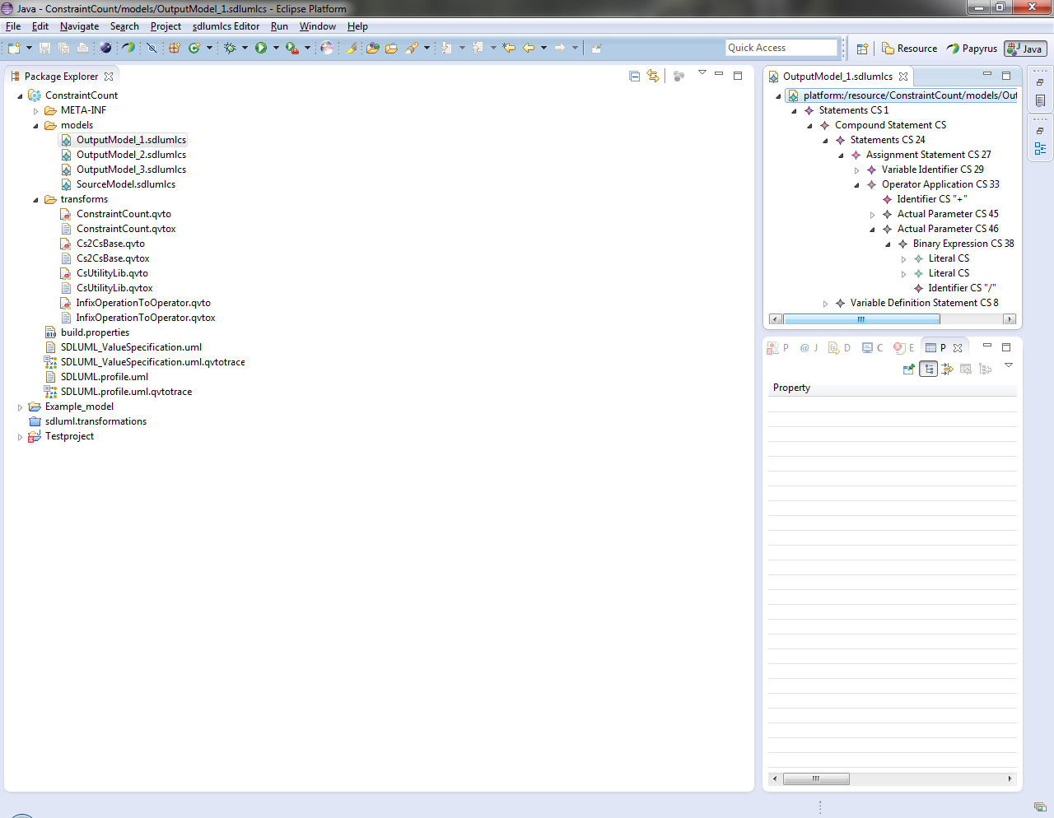
5. Exemplary Transformation Patterns
Top-level Simplification (1/3)
Output
Input

Slide 11
5. Exemplary Transformation Patterns
Top-level Simplification (2/3)
Mapping operation in CBT.
Overriding mapping operation
mapping CS::ExpressionCS::mapExpressionCS() : CS::ExpressionCS
disjuncts
  CS::EqualityExpressionCS::mapEqualityExpressionCS,
  CS::PrimaryCS::mapPrimaryCS,
  …
  CS::BinaryExpressionCS::mapBinaryExpressionCS { }
Overrides
mapping CS::ExpressionCS::mapExpressionCS() : CS::ExpressionCS
disjuncts
CS::EqualityExpressionCS::mapEqualityExpressionCS,
CS::PrimaryCS::mapPrimaryCS,
...
CS::BinaryExpressionCS::toOperatorApplication {}
Injected mapping operation

Slide 12
5. Exemplary Transformation Patterns
Top-level Simplification (3/3)
Mapping operation implementing the top-level simplification
mapping CS::BinaryExpressionCS::toOperatorApplication() : CS::OperatorApplicationCS
{
result.resolvedType := self.resolvedType;
result.resolvedOperation := self.resolvedOperation;
result.operationIdentifier := self.operationIdentifier;
result.actualParameters := OrderedSet {
object ActualParameterCS { expression := self.leftOperand },
object ActualParameterCS { expression := self.rightOperand }
};
}
No recursive mappings!

Slide 13
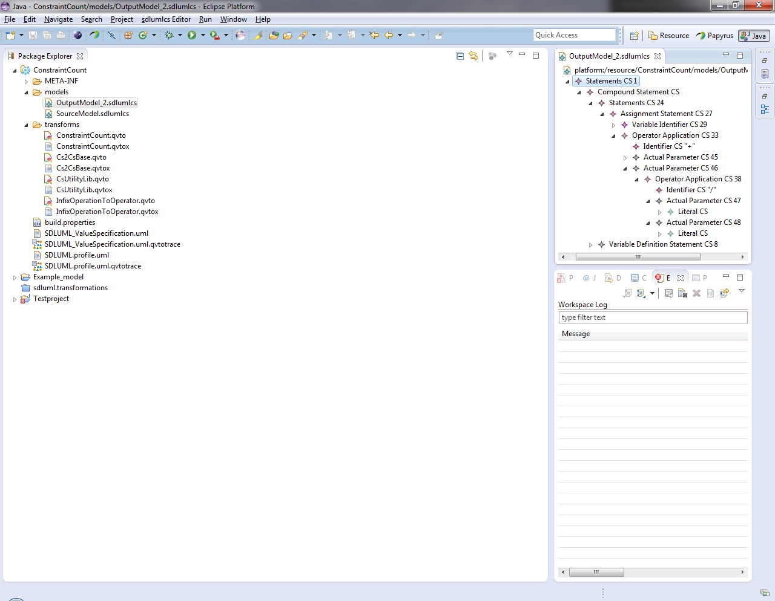
5. Exemplary Transformation Patterns
Recursive Simplification (1/2)
Output
Input

Slide 14
5. Exemplary Transformation Patterns
Recursive Simplification (2/2)
Mapping operation implementing the recursive simplification
mapping CS::BinaryExpressionCS::toOperatorApplication() : CS::OperatorApplicationCS
{
result.resolvedType := self.resolvedType;
result.resolvedOperation := self.resolvedOperation;
result.operationIdentifier := self.operationIdentifier;
result.actualParameters := OrderedSet {
object ActualParameterCS {
expression := self.leftOperand.map mapExpressionCS() },
object ActualParameterCS {
expression := self.rightOperand.map mapExpressionCS() }
};
}
Recursive mappings!

Slide 15
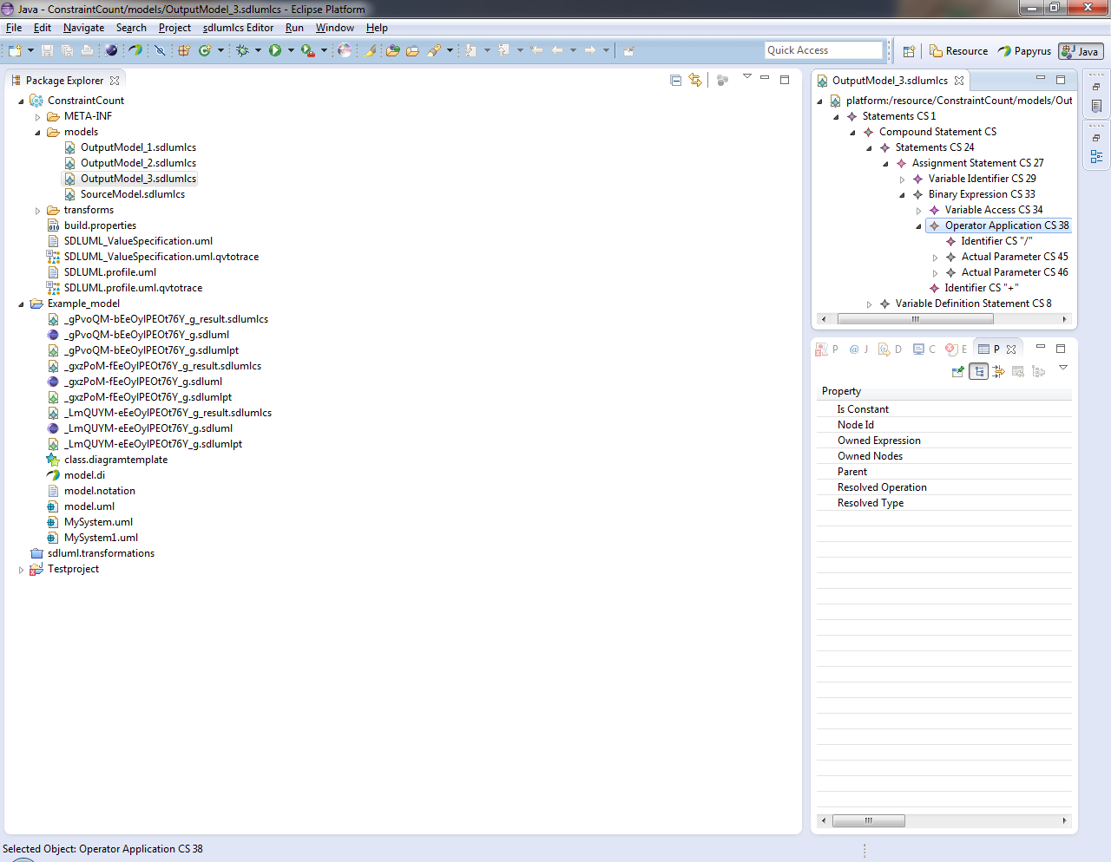
5. Exemplary Transformation Patterns
Simplification of Leaf Elements (1/2)
Input
Output

Slide 16
5. Exemplary Transformation Patterns
Simplification of Leaf Elements (2/2)
mapping CS::ExpressionCS::mapExpressionCS() : CS::ExpressionCS
disjuncts
...
CS::BinaryExpressionCS::toOperatorApplication,
CS::BinaryExpressionCS::mapBinaryExpressionCS {}
Must be placed before the default mapping in TCB!
mapping CS::BinaryExpressionCS::toOperatorApplication() : CS::OperatorApplicationCS
when { self.allSubobjectsOfType(CS::BinaryExpressionCS)->size() = 0 }
{ result.resolvedType := self.resolvedType;
result.resolvedOperation := self.resolvedOperation;
result.operationIdentifier := self.operationIdentifier;
result.actualParameters := OrderedSet {
object ActualParameterCS { expression := self.leftOperand },
object ActualParameterCS { expression := self.rightOperand } };
}
Necessary constraint!
No recursive mappings!

Slide 17
6. Conclusion
An approach for model simplifications resting on the refinement of a derived base transformation was presented.
Further simplification patterns can be implemented in the same manner.
Also other kinds of endogenous model transformations should be realizable in a similar manner.
Running example can be obtained from:
http://www.su-moval.org/model_simplifications/QVT-O_model_simplification_examples.html

