Slide 1
Analysing Product Lines of Concurrent Systems
Elena Gómez-Martínez, Juan de Lara and Esther Guerra
Universidad Autónoma de Madrid
Petri Nets for MDE
Applications to Software Product Lines
José Ignacio Requeno
Elena Gómez-Martínez
Melanie Haustein
Hannes Kallwies
Martin Leucker
Volker Stolz
Patrick Stünkel

Slide 2
Index
Motivation
Basic Concepts
Petri Net Product Lines
Analysis of PNPL
Tool Support: Titan
Conclusions and Further Work

Slide 3
Motivation
Petri nets: Modelling formalism for concurrent systems
Basics: Places, arcs, weights and transitions
parallelism
synchronization
mutex & resources …

Slide 4
Motivation
Petri nets: Modelling formalism for concurrent systems
Basics: Places, arcs, weights and transitions

Slide 5
Motivation
Structural analysis (static)
P/T Invariants, deadlocks
State space exploration, CTL, testing
Dynamic analysis (dynamic)
Performance analysis (response time, resource usage)
Runtime verification, TeSSLa

Slide 6
Motivation
Enriching expressivity of Petri nets
Time, probabilities, priorities, colours, product lines, …
Domain Specific Languages (DSL’s)
Annotations for High Level Modelling Languages (e.g., UML)
Transformation to Petri nets (or other formalism) for analysis
Some examples: MARTE, DICE

Slide 7
Motivation
DICE
DICE Project
DICE Project Wiki
DICE Blog
DICE IDE
DICE Simulation tool
Developing Data-Intensive Cloud Applications with Iterative Quality Enhancements

Slide 8
Index
Motivation
Basic Concepts
Petri Net Product Lines
Analysis of PNPL
Tool Support: Titan
Conclusions and Further Work

Slide 9
Basic Concepts
Petri net
PN=(P, T, A $⊆\left(P×T\right)∪\left(T×P\right)$)
P and T are disjoint set of places and transitions
A is the set of arcs connecting either places to transitions or vice versa.

Slide 10
Motivation
A(possibly large) family of similar systems
Analysis of each product is costly
Analyse just once, instead of once per product

Slide 11
Motivation
Example: An assembly line
gen_{B}
cnv_{B}
out₁
cnv₁
inc₁
prod₁
in
ctrl
prod
pack
out₂
cnv₂
inc₂
proc
assembly
gen_{A}
cnv_{A}
fix
prod₂

Slide 12
Basic Concepts
Product Line (SL)
Set of products that share a number of core properties, but also differ in certain well-defined aspects.
Features
A distinguishing characteristic of a system.
Variability
Ability to change or customize a system.
Notes:
Product Line (SL)
Set of products that share a number of core properties, but also differ in certain well-defined aspects.
To minimize the cost of developing and evolving products that are part of a product family.
Features
The differences between the products can be described in terms of features.
A distinguishing characteristic of a system.
Variability
Ability to change or customize a system.
Improving variability in a system implies making it easier to do certain kinds of changes.

Slide 13
Basic Concepts
Feature Model
Compact representation of all the products of the PL in terms of features
It contains all the feature options available for all the products in that product line
FlexibleAssemblyLine
Legend:
Mandatory
InParts
Process
OutProducts
Optional
Or Group
PartA
PartB
QualityControl
Parallel
Prod1
Prod2
Alternative
cross-tree constraints: Prod2 ⇒ PartA ∧ PartB

Slide 14
Basic Concepts
Feature Model
$$FM=\left(F,Ψ\right)$$
$F= \left\{f_{1},f_{2},…,f_{n}\right\}$ is a set of features
A propositional formula $Ψ$ over $F$ fixing the allowed feature configurations
FlexibleAssemblyLine
Legend:
Mandatory
InParts
Process
OutProducts
Optional
Or Group
PartA
PartB
QualityControl
Parallel
Prod1
Prod2
Alternative
cross-tree constraints: Prod2 ⇒ PartA ∧ PartB
Notes:
A feature model FM = (F; Phi ) consists of a set of propositional variables
F = {f1, f2; …; fn} called features, and a propositional formula over the variables in F.
Figure shows the feature model for the running example. The upper part (a) uses the standard feature diagram
notation [24], and the lower part (b) uses the definition on the left side 6.
Overall, the model requires choosing at least one of the Container items: Tea, Coffee or Solid, and optionally one or more Supplements. The cross-tree constraints at the bottom of Fig 2(a) specify that Sugar is only allowed if some Beverage is chosen, while Milk is only available for Coffee.

Slide 15
Index
Motivation
Basic Concepts
Petri Net Product Lines
Analysis of PNPL
Tool Support: Titan
Conclusions and Further Work

Slide 16
Petri Net Product Line
A Petri Net Product Line (PNPL)
$$PNL=\left\{FM,𝒩,φ\right\}$$
A feature model $FM$,
A Petri net $𝒩$(called the 150% Petri net)
A tuple $Φ=\left(φ_{P},φ_{T},φ_{A}\right)$ of mappings.
A Petri net whose elements can be annotated with boolean formulae over the features of the feature model.
Notes:
A PNPL $PNL=\left\{FM,PN,φ\right\}$ is made of a feature model $FM$, a Petri net $PN$ (called the 150% Petri net), and a tuple $φ=\left(φ_{P},φ_{T},φ_{A}\right)$ of mappings. Each mapping $φ_{X}$ (for $X∈\left\{P,T.A\right\}$) consists of pairs $\left\langle x,φ_{x}\right\rangle$ mapping an element (a place, a transition, an arc) $x∈X$ to a propositional formula $φ_{x}$ (called the presence condition (PC) of $x$) over the features in $FM$.

Slide 17
Petri Net Product Line
Feature configuration:
A valid configuration of $ρ⊆FM$ of a $FM$ is a subset of its features satisfying $Ψ$
It evaluates true when a variable $f∈φ$ is substituted by true when $f∈ρ$
Notes:
Selecting one variant is done by providing a configuration, which identifies the features that are selected and unselected.
Where each element is annotated with the variant it belongs to.

Slide 18
Petri Net Product Line
Presence condition
Pair $\left\langle x,φ_{x}\right\rangle$ to a propositional formula $φ_{x}$ over the features in $FM$, being $x ∈P∪T∪A$
If $φ_{x}=True →x exists$
Notes:
Conceptually, such Petri nets contains superimposed all the variants of the family, and for this reason is called 150% Petri net. Please note that in this notion of product line, we consider only the net structure and not its marking, since the structure is where the variability is to be found.

Slide 19
Petri Net Product Line
Petri net derivation:
${PN}_{ρ}$
Using a configuration $ρ$ if ${PN}_{ρ}$ contains exactly those elements from the 150% Petri net whose PCs are satisfied for the features in $ρ$.
All derivable Petri nets from the PNPL are the products.
Notes:
${PN}_{ρ}$ is derived from a PNPL with a feature model $FM$ using a configuration $ρ$ if ${PN}_{ρ}$ contains exactly those elements (places, transitions, arcs) from the 150% Petri net whose PCs are satisfied for the features in $ρ$.

Slide 20
Petri Net Product Line
Example:
FlexibleAssemblyLine
Legend:
Mandatory
InParts
Process
OutProducts
Optional
Or Group
PartA
PartB
QualityControl
Parallel
Prod1
Prod2
Alternative
cross-tree constraints: Prod2 ⇒ PartA ∧ PartB
gen_{B}
cnv_{B}
out₁
cnv₁
inc₁
prod₁
in
ctrl
prod
pack
out₂
cnv₂
inc₂
proc
assmbly
gen_{A}
cnv_{A}
fix
prod₂
Notes:
The sequence of two transitions (sel solid, solid end) and two places (solid, tray) and five arcs has PC Solid. These elements – which enable the selection of solid items – are only present in the net, if the feature Solid is present in a configuration. Similarly, we have included elements to model the choice of tea, coffee, sugar and milk.

Slide 21
Petri Net Product Line
Example:
FlexibleAssemblyLine
Legend:
Mandatory
InParts
Process
OutProducts
Optional
Or Group
PartA
PartB
QualityControl
Parallel
Prod1
Prod2
Alternative
cross-tree constraints: Prod2 ⇒ PartA ∧ PartB
[PartB]
[Prod1]
gen_{B}
cnv_{B}
out₁
cnv₁
inc₁
prod₁
[Prod1∧Prod2]
in
ctrl
prod
pack
out₂
cnv₂
inc₂
proc
assmbly
gen_{A}
cnv_{A}
fix
[Parallel]
prod₂
[PartA]
[Prod2]
[QualityControl]
Notes:
The sequence of two transitions (sel solid, solid end) and two places (solid, tray) and five arcs has PC Solid. These elements – which enable the selection of solid items – are only present in the net, if the feature Solid is present in a configuration. Similarly, we have included elements to model the choice of tea, coffee, sugar and milk.

Slide 22
Index
Motivation
Basic Concepts
Petri Net Product Lines
Analysis of PNPL
Tool Support
Conclusions and Further Work

Slide 23
Analysis of PNPL
Structural properties
Dependent only on the net topology
Independent of the initial marking
Notes:
As all of us know, structural properties are those which depend only on the net topology, therefore they are independent of the initial marking.
Some of them: state machine, marked graph, free choice, invariants

Slide 24
Analysis of PNPL: Structural
State Machine
A Petri net $𝒩=\left(P,T,A\right)$ is a state-machine, if $∀ t ∈T : \left|\text{•}t\right|=\left|t\text{•}\right|=1$

Slide 25
Analysis of PNPL: Structural
State Machine
A Petri net $𝒩=\left(P,T,A\right)$ is a state-machine, if $∀ t ∈T : \left|\text{•}t\right|=\left|t\text{•}\right|=1$
p1
t1
p2
p3
t2

Slide 26
Analysis of PNPL: Structural
State Machine
A Petri net $𝒩=\left(P,T,A\right)$ is a state-machine, if $∀ t ∈T : \left|\text{•}t\right|=\left|t\text{•}\right|=1$
p1
t1
p2
This net is not SM
$t_{1}• = \{p2, p3\}$
$$\left|t_{1}•\right| =2$$
p3
t2

Slide 27
Analysis of PNPL: Structural
State Machine
A Petri net $𝒩=\left(P,T,A\right)$ is a state- machine, if $∀ t ∈T : \left|\text{•}t\right|=\left|t\text{•}\right|=1$
PN
p1
t1
p2
f
g
[g]
[g]
p3
We have 4 configs:
<>,<f>, <g>, <f, g>
t2
[f∨g]

Slide 28
Analysis of PNPL: Structural
State Machine
t1: any configuration where g=true is not a SM
t2: only when $fg$, is SM when $fg$
$<>$ is a SM
$<f>$ is not a SM
$<g>$ is not a SM
$<f,g>$ is not a SM
p1
t1
p2
[g]
[g]
p3
t2
[f∨g]
Notes:
Going through the conditions for each transition, we have that:
t1: any configuration where g=true is not a SM
t2: only when $fg$, is SM when $fg$
Therefore, if we look at configurations:
$<>$ is a SM
$<f>$ is not a SM
$<g>$ is not a SM
$<f,g>$ is not a SM

Slide 29
Analysis of PNPL: Structural
State Machine
$$\text{•}t_{1}= \left\{\left(p1, true\right)\right\}$$
$$t_{1}\text{•}=\{(p2, true), (p3, g)\}$$
$$\text{•}t_{2}= \left\{\left(p3, f\right)\right\}$$
$$t_{2}\text{•}=\{(p1, g)\}$$
And so:
$\left|\text{•}t_{1}\right|=1$ always
$\left|t_{1}\text{•}\right|=1$when $g=false$
$\left|\text{•}t_{2}\right|=1$when $f=true$
$\left|t_{2}\text{•}\right|=1$ when $g=true$
p1
t1
p2
[g]
[g]
p3
t2
[f∨g]

Slide 30
Analysis of PNPL: Structural
State Machine
$$true  true  ➢g $$
$$f  g  f  g$$
(this is false, since true does not imply not g)
p1
t1
p2
[g]
[g]
p3
t2
[f∨g]

Slide 31
Analysis of PNPL: Structural
State Machine
$$true  true  ➢g $$
$$f  g  f  g$$
(this is false, since true does not imply not g)
(this is also false)
p1
t1
p2
[g]
[g]
p3
t2
[f∨g]

Slide 32
Analysis of PNPL: Structural
State Machine
$$true  true  ➢g $$
$$f  g  f  g$$
(this is false, since true does not imply not g)
(this is also false)
p1
t1
p2
[g]
Therefore, not all products are SMs
[g]
p3
t2
[f∨g]

Slide 33
Analysis of PNPL: Structural
State Machine analysis
Presence Conditions in the 150%
Lift the definition of the SM property to the product line level.
A PNPL is a SM if all its derivable nets are SMs.

Slide 34
Analysis of PNPL: Structural
Lifted pre-/post-sets of a transition
Given a PNPL $PNL=(FM,𝒩,Φ)$ and a place $t∈T$, the lifted pre-set of $t$ is
$$°t=\{(p,Φ_{(p,t)})│(p,t)∈A\}$$
while its lifted post-set is
$$t°=\{(p,Φ_{(t,p)})│(t,p)∈A\}$$
Notes:
To improve the efficiency of their analysis, we do not examine each derivable Petri net in $Prod(PNL)$ separately.
Instead, we work at the product line level by analysing the
PCs in the 150\% Petri net to determine if a particular element (place, transition or arc) is in $Prod(PNL)$. For this purpose, first we lift the definition of the MG property to the product line level. A PNPL is a MG if all its derivable nets are MGs.

Slide 35
Analysis of PNPL: Structural
Lifted pre-/post-sets of a transition
Given a PNPL $PNL=(FM,𝒩,Φ)$ and a place $t∈T$, the lifted pre-set of $t$ is
$$°t=\{(p,Φ_{(p,t)})│(p,t)∈A\}$$
while its lifted post-set is
$$t°=\{(p,Φ_{(t,p)})│(t,p)∈A\}$$
$$Φ_{°t}≜false∨$$
$$\left(Φ_{\left(p_{o},t\right)}∧{¬Φ}_{\left(p_{1},t\right)}∧⋯∧{¬Φ}_{\left(p_{n},t\right)}\right)∨$$
$$\left({¬Φ}_{\left(p_{o},t\right)}∧Φ_{\left(p_{1},t\right)}∧⋯∧{¬Φ}_{\left(p_{n},t\right)}\right)∨⋯$$
$$\left({¬Φ}_{\left(p_{o},t\right)}∧{¬Φ}_{\left(p_{1},t\right)}∧⋯∧Φ_{\left(p_{n},t\right)}\right)$$
Notes:
To improve the efficiency of their analysis, we do not examine each derivable Petri net in $Prod(PNL)$ separately.
Instead, we work at the product line level by analysing the
PCs in the 150\% Petri net to determine if a particular element (place, transition or arc) is in $Prod(PNL)$. For this purpose, first we lift the definition of the MG property to the product line level. A PNPL is a MG if all its derivable nets are MGs.

Slide 36
Analysis of PNPL: Structural
Lifted pre-/post-sets of a transition
$t$ is not in ${PN}_{ρ}$, therefore $Φ_{t}$ is false; or
$t$ is in ${PN}_{ρ}$, therefore $Φ_{°t}$ and $Φ_{t°}$ need to be true
These conditions are expressed as the formula:
$$Φ=(⋀_{t∈T}\left[¬Φ_{t}∨(Φ∧Φ_{°t}∧Φ_{t°})\right]$$
Predicate $SAT(Ψ∧Φ)$
Notes:
If there is a feature configuration such that SAT( ^SM) holds, then there is a derivable Petri net that is a SM, and the PNPL is a weak SM. On the contrary, the feature configurations that produce nets which are not SMs are those making the formula $Φ$ is true. Hence, the PNPL is a strong SM if
SAT($Ψ,not Φ$) does not hold.

Slide 37
Analysis of PNPL: Structural
Marked Graph
Free-Choice
Extended Free-Choice
Gómez-Martínez, E., de Lara, J., Guerra, E. (2021). Extensible Structural Analysis of Petri Net Product Lines. In: Koutny, M., Kordon, F., Pomello, L. (eds) Transactions on Petri Nets and Other Models of Concurrency XV. Lecture Notes in Computer Science(), vol 12530. Springer

Slide 38
Analysis of PNPL: Structural
Lifted pre-/post-sets of a place
Given a PNPL $PNL=(FM,𝒩,Φ)$ and a place $p∈P$, the lifted pre-set of $p$ is
$°p=\left\{(t,Φ_{\left(t,p\right)}) | (t,p)∈A\right\}$
while its lifted post-set is
$$p°=\left\{(t,Φ_{\left(p,t\right)}) | (p,t)∈A\right\}$$
Notes:
To improve the efficiency of their analysis, we do not examine each derivable Petri net in $Prod(PNL)$ separately.
Instead, we work at the product line level by analysing the
PCs in the 150\% Petri net to determine if a particular element (place, transition or arc) is in $Prod(PNL)$. For this purpose, first we lift the definition of the MG property to the product line level. A PNPL is a MG if all its derivable nets are MGs.

Slide 39
Analysis of PNPL: Structural
Lifted pre-/post-sets of a place
Given a PNPL $PNL=(FM,𝒩,Φ)$ and a place $p∈P$, the lifted pre-set of $p$ is
$°p=\left\{(t,Φ_{\left(t,p\right)}) | (t,p)∈A\right\}$
while its lifted post-set is
$$p°=\left\{(t,Φ_{\left(p,t\right)}) | (p,t)∈A\right\}$$
$$Φ_{°p}≜\left(Φ_{\left(t_{o},p\right)}∧{¬Φ}_{\left(t_{1},p\right)}∧⋯∧{¬Φ}_{\left(t_{n},p\right)}\right)∨\left({¬Φ}_{\left(t_{o},p\right)}∧Φ_{\left(t_{1},p\right)}∧⋯∧{¬Φ}_{\left(t_{n},p\right)}\right)∨⋯\left({¬Φ}_{\left(t_{o},p\right)}∧{¬Φ}_{\left(t_{1},p\right)}∧⋯∧Φ_{\left(t_{n},p\right)}\right)$$
Notes:
To improve the efficiency of their analysis, we do not examine each derivable Petri net in $Prod(PNL)$ separately.
Instead, we work at the product line level by analysing the
PCs in the 150\% Petri net to determine if a particular element (place, transition or arc) is in $Prod(PNL)$. For this purpose, first we lift the definition of the MG property to the product line level. A PNPL is a MG if all its derivable nets are MGs.

Slide 40
Analysis of PNPL: Structural
Lifted pre-/post-sets of a place
$p$ is not in ${PN}_{ρ}$, therefore $Φ_{p}$ is false; or
$p$ is in ${PN}_{ρ}$, therefore $Φ_{°p}$ and $Φ_{p°}$ need to be true
These conditions are expressed as the formula:
$Φ=(⋀_{p∈P}\left[¬Φ_{p}∨(Φ∧Φ_{°p}∧Φ_{p°})\right]$
Predicate $SAT(φ∧Φ)$
Notes:
To improve the efficiency of their analysis, we do not examine each derivable Petri net in $Prod(PNL)$ separately.
Instead, we work at the product line level by analysing the
PCs in the 150\% Petri net to determine if a particular element (place, transition or arc) is in $Prod(PNL)$. For this purpose, first we lift the definition of the MG property to the product line level. A PNPL is a MG if all its derivable nets are MGs.

Slide 41
Analysis of PNPL: Structural
P-invariants
Given a Petri net $𝒩$, a P-invariant is a non-trivial integer vector $y$ (with rank m) satisfying:
$$ℂy = 0 where each y_{i}≥0$$
Being $ℂ$, the incident matrix of $𝒩$
Notes:
To improve the efficiency of their analysis, we do not examine each derivable Petri net in $Prod(PNL)$ separately.
Instead, we work at the product line level by analysing the
PCs in the 150\% Petri net to determine if a particular element (place, transition or arc) is in $Prod(PNL)$. For this purpose, first we lift the definition of the MG property to the product line level. A PNPL is a MG if all its derivable nets are MGs.

Slide 42
Analysis of PNPL: Structural
150% incidence matrix
Given a PNPL $PNL = (FM,𝒩= \left(P, T,A\right), Φ)$with $n = |T|$ and $m = |P|$, the incidence matrix of the 150% Petri net is the $n × m$ matrix containing all the incidence matrices of all the derivable ${PN}_{i}.$

Slide 43
Analysis of PNPL: Structural
Matrix of Presence Conditions
Given a PNPL $PNL = (FM,𝒩= \left(P, T,A\right), Φ)$with $n = |T|$ and $m = |P|$, the presence conditions matrix $𝔽=\left|f_{ij}\right|$ is a ($n+1)×(m+1)$ matrix of logical formulae
$$f_{ij}=\left\{\begin{aligned}Φ_{a_{ij}}, if i≤n ∧j≤m then a_{ij}∈A \\ Φ_{j}, if i=n+1 ∧j≤m then j∈P \\ Φ_{i}, if i≤n+1 ∧j=m+1 then i∈T \\ 0, otherwise\end{aligned}\right.$$

Slide 44
Analysis of PNPL: Structural
Presence Conditions Matrix
Given a PNPL $PNL = (FM,𝒩= \left(P, T,A\right), Φ)$with $n = |T|$ and $m = |P|$, the presence conditions matrix $𝔽=\left|f_{ij}\right|$ is a ($n+1)×(m+1)$ matrix of logical formulae
$$𝔽=\left|\begin{matrix}Φ_{a_{11}} & Φ_{a_{12}} & … & Φ_{a_{1m}} & Φ_{t_{1}} \\ Φ_{a_{21}} & Φ_{a_{22}} & … & Φ_{a_{2m}} & Φ_{t_{2}} \\ ⋮ & ⋮ & ⋱ & ⋮ & ⋮ \\ Φ_{a_{n1}} & Φ_{a_{n2}} & … & Φ_{a_{nm}} & Φ_{t_{n}} \\ Φ_{p_{1}} & Φ_{p_{2}} & … & Φ_{p_{m}} & 0\end{matrix}\right|$$

Slide 45
Analysis of PNPL: Structural
Lifted Incidence Matrix
Given a PNPL $PNL = (FM,𝒩= \left(P, T,A\right), Φ)$with $n = |T|$ and $m = |P|$, the lifted incidence matrix $𝕃=\left|l_{ij}\right|$ is a ($n+1)×(m+1)$ matrix of logical formulae
$$l_{ij}=\left\{\begin{aligned}f_{ij}⋅c_{ij}, if i≤n ∧j≤m \\ 0, otherwise\end{aligned}\right.$$

Slide 46
Analysis of PNPL: Structural
Lifted Incidence Matrix
Given a PNPL $PNL = (FM,𝒩= \left(P, T,A\right), Φ)$with $n = |T|$ and $m = |P|$, the lifted incidence matrix $𝕃=\left|l_{ij}\right|$ is a ($n+1)×(m+1)$ matrix of logical formulae
$$𝕃=\left|\begin{matrix}Φ_{a_{11}}⋅c_{11} & Φ_{a_{12}}⋅c_{12} & … & Φ_{a_{1m}}⋅c_{1m} & Φ_{t_{1}} \\ Φ_{a_{21}}⋅c_{21} & Φ_{a_{22}}⋅c_{22} & … & Φ_{a_{2m}}⋅c_{2m} & Φ_{t_{2}} \\ ⋮ & ⋮ & ⋱ & ⋮ & ⋮ \\ Φ_{a_{n1}}⋅c_{n1} & Φ_{a_{n2}}⋅c_{n2} & … & Φ_{a_{nm}}⋅c_{nm} & Φ_{t_{n}} \\ Φ_{p_{1}} & Φ_{p_{2}} & … & Φ_{p_{m}} & 0\end{matrix}\right|$$

Slide 47
Analysis of PNPL: Structural
P-invariant analysis
Given a PNPL $PNL = (FM,𝒩= \left(P, T,A\right), Φ)$has a strong (weak) p-invariant if all (some) its derivable nets have p-invariants.
$$𝕃y=0 such as y≥0$$

Slide 48
Analysis of PNPL: Structural
P-invariant analysis
Given a PNPL $PNL = (FM,𝒩= \left(P, T,A\right), Φ)$has a strong (weak) p-invariant if all (some) its derivable nets have p-invariants.
$$\begin{matrix}{Φ_{t_{1}}⇒(Φ}_{a_{11}}⋅c_{11})y_{1}+ & \left(Φ_{a_{12}}⋅c_{12}\right)y_{2}+ & … & + (Φ_{a_{1m}}⋅c_{1m})y_{m} & =0 \\ Φ_{t_{2}}{⇒(Φ}_{a_{21}}⋅c_{21})y_{1}+ & {(Φ}_{a_{22}}⋅c_{22})y_{2}+ & … & +(Φ_{a_{2m}}⋅c_{2m})y_{m} & =0 \\ ⋮ & ⋮ & ⋱ & ⋮ & ⋮ \\ Φ_{t_{n}}{⇒(Φ}_{a_{n1}}⋅c_{n1})y_{1}+ & {(Φ}_{a_{n2}}⋅c_{n2})y_{2}+ & … & +(Φ_{a_{nm}}⋅c_{nm})y_{m} & =0 \\ \begin{aligned}\begin{aligned}Φ_{p_{1}}⇒y_{1}≥0 \\ Φ_{p_{2}}⇒y_{2}≥0\end{aligned} \\ ⋮ \\ Φ_{p_{m}}⇒y_{m}≥0\end{aligned} & & … & & \end{matrix}$$
Notes:
As it can been observed, these linear equations combine
both arithmetic and logical expressions. In addition, we must
include the feature model itself,

Slide 49
Analysis of PNPL: Structural
P-invariant analysis
Given a PNPL $PNL = (FM,𝒩= \left(P, T,A\right), Φ)$has a strong (weak) p-invariant if all (some) its derivable nets have p-invariants.
$$\begin{matrix}{Φ_{t_{1}}⇒(Φ}_{a_{11}}⋅c_{11})y_{1}+ & \left(Φ_{a_{12}}⋅c_{12}\right)y_{2}+ & … & + (Φ_{a_{1m}}⋅c_{1m})y_{m} & =0 \\ Φ_{t_{2}}{⇒(Φ}_{a_{21}}⋅c_{21})y_{1}+ & {(Φ}_{a_{22}}⋅c_{22})y_{2}+ & … & +(Φ_{a_{2m}}⋅c_{2m})y_{m} & =0 \\ ⋮ & ⋮ & ⋱ & ⋮ & ⋮ \\ Φ_{t_{n}}{⇒(Φ}_{a_{n1}}⋅c_{n1})y_{1}+ & {(Φ}_{a_{n2}}⋅c_{n2})y_{2}+ & … & +(Φ_{a_{nm}}⋅c_{nm})y_{m} & =0 \\ \begin{aligned}\begin{aligned}Φ_{p_{1}}⇒y_{1}≥0 \\ Φ_{p_{2}}⇒y_{2}≥0\end{aligned} \\ ⋮ \\ Φ_{p_{m}}⇒y_{m}≥0\end{aligned} & & … & & \end{matrix}$$
Constraint Satisfaction Problem
Notes:
As it can been observed, these linear equations combine
both arithmetic and logical expressions. In addition, we must
include the feature model itself,

Slide 50
Analysis of PNPL: Structural
P-invariant analysis
T-invariant analysis

Slide 51
Analysis of PNPL: Structural
P-invariant analysis
T-invariant analysis
Gómez-Martínez, Elena and Guerra, Esther and de Lara, Juan and Garmendia, Antonio, Lifted Invariant Analysis of Petri Net Product Lines. Submitted to Journal of Logical and Algebraic Methods in Programming (major revision)

Slide 52
Analysis of PNPL: Behavioural
Behavioural properties
Which depends on the initial marking
Notes:
Some of them: state machine, marked graph, free choice, invariants

Slide 53
Analysis of PNPL: Behavioural
Behavioural properties
Which depends on the initial marking
→ Transforming PNPL into CPN
Notes:
Some of them: state machine, marked graph, free choice, invariants

Slide 54
Analysis of PNPL: Behavioural
Transformation into CPNs
Activate/Deactivate elements in the net structure
Using guards or expressions in the CPN
Notes:
Some of them: state machine, marked graph, free choice, invariants

Slide 55
Analysis of PNPL: Behavioural
Transformation into CPNs: Feature Model
Two coloursets to encode configuration
colset FEATURE = BOOL;
colset CONFIGURATION = record INPARTS : FEATURE * PARTA : FEATURE * PARTB : FEATURE * PROCESS : FEATURE * QUALITYCONTROL : FEATURE * PARALLEL : FEATURE * OUTPRODUCTS : FEATURE * PROD1 : FEATURE * PROD2 : FEATURE;
A place for any and transitions for switches
A place for the current configuration
var InParts, PartA, PartB, Process, QualityControl, Parallel, OutProducts, Prod1, Prod2 : FEATURE;
var c, d : CONFIGURATION;
Notes:
Some of them: state machine, marked graph, free choice, invariants

Slide 56
Analysis of PNPL: Behavioural
Transformation into CPNs: Feature Model
Check any configuration
fun implies (p,q) = not p orelse q;
fun iff (p, q) = ((not p orelse q) andalso (p orelse not q));
fun isValid (PARAM_FlexibleAssemblyLine, PARAM_Prod1, PARAM_QualityControl, PARAM_Prod2, PARAM_InParts, PARAM_PartB, PARAM_Process, PARAM_PartA, PARAM_Parallel, PARAM_OutProducts) = iff(PARAM_InParts,PARAM_FlexibleAssemblyLine) andalso iff(PARAM_Process,PARAM_FlexibleAssemblyLine) andalso iff(PARAM_OutProducts,PARAM_FlexibleAssemblyLine) andalso (PARAM_PartA orelse PARAM_PartB) andalso (implies(PARAM_QualityControl,PARAM_Process) andalso implies(PARAM_Parallel,PARAM_Process)) andalso (PARAM_Prod1 orelse PARAM_Prod2) andalso implies(PARAM_Prod2,(PARAM_PartA andalso PARAM_PartB));
Notes:
Some of them: state machine, marked graph, free choice, invariants

Slide 57
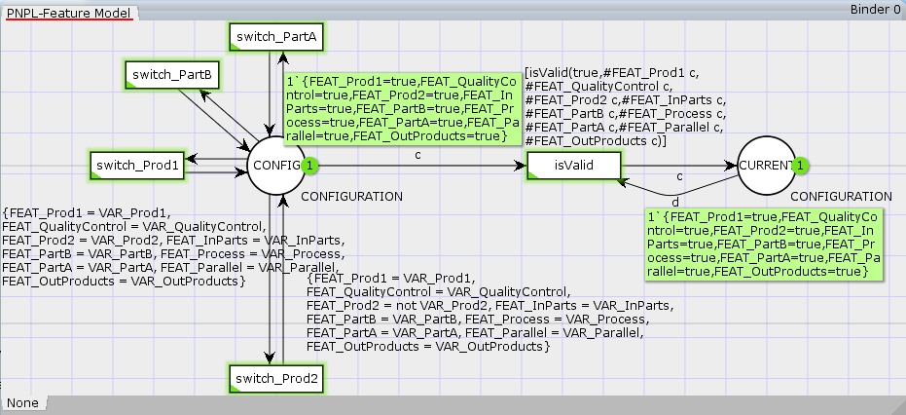
Analysis of PNPL: Behavioural
Transformation into CPNs: Feature Model
Notes:
Some of them: state machine, marked graph, free choice, invariants

Slide 58
Analysis of PNPL: Behavioural
Transformation into CPNs: 150% net
Net structure
gen_{B}
cnv_{B}
out₁
cnv₁
inc₁
prod₁
in
ctrl
prod
pack
out₂
cnv₂
inc₂
proc
assmbly
gen_{A}
cnv_{A}
fix
prod₂
Notes:
Some of them: state machine, marked graph, free choice, invariants

Slide 59
Analysis of PNPL: Behavioural
Transformation into CPNs: 150% net
Present conditions in transitions
Transitions guards
Present conditions in arcs
Expressions in arcs
if (#FEAT_Prod1 c andalso #FEAT_Prod2 c) then 1ˋ1 else 0ˋ1
Notes:
Some of them: state machine, marked graph, free choice, invariants

Slide 60
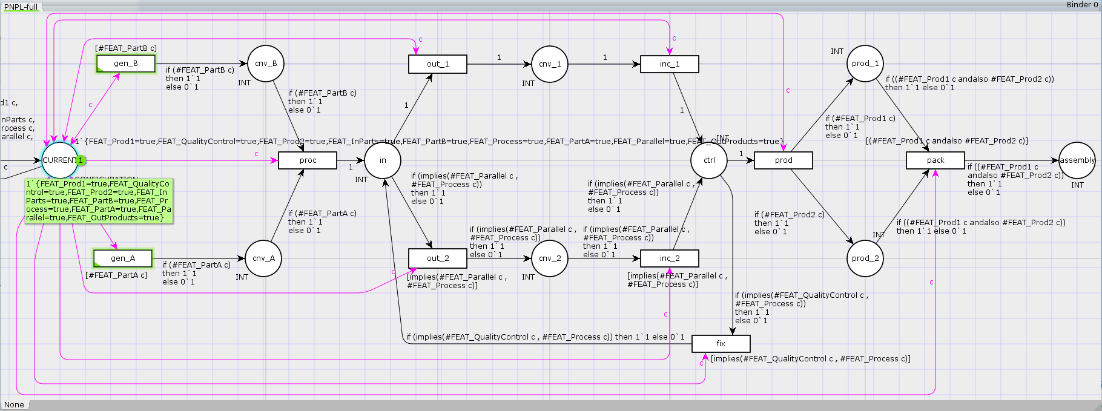
Analysis of PNPL: Behavioural
Transformation into CPNs: 150% net
Notes:
Some of them: state machine, marked graph, free choice, invariants

Slide 61
Analysis of PNPL: Behavioural
Transformation into CPNs
Gómez-Martínez, E., de Lara, J., Guerra, E. (2022). Analysing Product Lines of Concurrent Systems with Coloured Petri Nets. Accepted in The 34th International Conference on Software Engineering & Knowledge Engineering (SEKE 2022)
Notes:
Some of them: state machine, marked graph, free choice, invariants

Slide 62
Analysis of PNPL: Simulation
Properties that are infeasible or impossible to validate from the net structure
Performance evaluation:
Response time, resource usage,…. (min, max, avg)
Safety and security checking:
Privacy policies, dynamic memory,….
response = #tokens/t
usage = #tokens/#max_tokens
Notes:
Some of them: state machine, marked graph, free choice, invariants

Slide 63
Analysis of PNPL: Monitoring
System
Observation
Report
Monitor
Executable
Configuration
Specification: Behaviour, Observations

Slide 64
Analysis of PNPL: Runtime Verification
TeSSLa: a Temporal Stream-based Specification Language (& Toolchain)
Declarative style: Specification rather than implementation
Modularity: Allow high-level abstractions
Time as first-class citizen
Discrete events (e.g. function calls)
Persistent signals (e.g. variables)
variable event rates and sampling frequencies
Sparse event streams: high accuracy time stamps, low frequency
Recursive definitions to reason about past
Implementable with limited memory

Slide 65
Analysis of PNPL: Runtime Verification

Slide 66
Analysis of PNPL: Runtime Verification
t₀
Worker
t₃
2
2
2h
t₁
Todo
t₂
Finished

Slide 67
Analysis of PNPL: Runtime Verification

Slide 68
Analysis of PNPL: Runtime Verification
import Petri Net. NonTokenTracking.Places
import Petri Net. NonTokenTracking.T ransitions
% Static part corresponding directly to the net:
in t0: Events [Int]
in t1: Events [Int]
in t2: Events [Int]
in t3: Events [Int]
def Worker1 = FIFOPlace (addTransitions(t0, delay Tokens (2 * t2, 2h) ) ,
addTransitions(2 * t2, t3) ,
0, None [Int])
def Todo = FIFOPlace (t1, t2, 0, None [Int])
def timeCrit = Todo.maxWaitTimeT(time(period(10 min))) > 5h
def error = timeCrit && Worker1.tokenCnt >= 2
out error

Slide 69
Analysis of PNPL: Runtime Verification

Slide 70
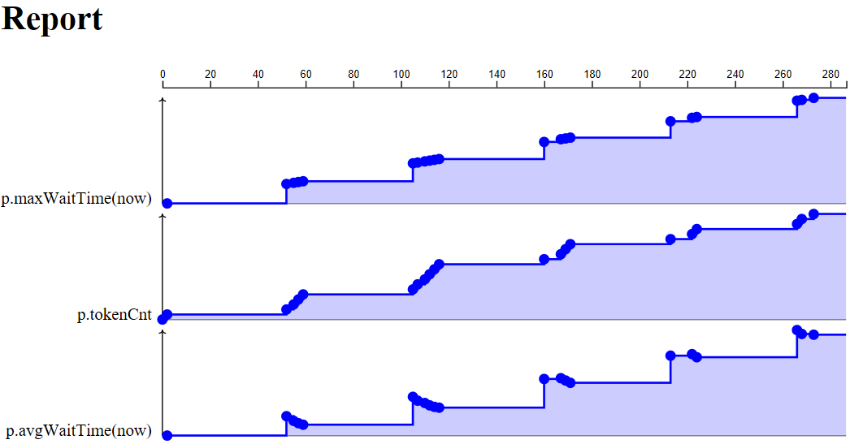
Analysis of PNPL: Runtime Verification

Slide 71
Analysis of PNPL: Behavioural
Runtime verification of Timed Petri nets
Gómez-Martínez, E., et al. (2023). Runtime Verification of Timed Petri Nets. Submitted to The 23rd International Conference on Runtime Verification (RV 2023)
Notes:
Some of them: state machine, marked graph, free choice, invariants

Slide 72
Index
Motivation
Basic Concepts
Petri Net Product Lines
Structural Analysis of Petri Net Product Lines
Tool Support: Titan
Conclusions and Further Work

Slide 73
Tool Support
CPN Tools
Eclipse plugin
CPN Tools
«uses»
Export
TimeNET
WoPeD
Composer
GreatSPN
FeatureIDE
Titan
MarkedGraph
Petrinets
Sirius Editor
Property
Analysis
StateMachine
FreeChoice
«uses»
ExtendedFreeChoice
Sat4j
P-Invariants
Feature
model
Feature
configuration
150% Petri net
model with PCs
T-Invariants
…
«uses»
JaCoP
Analysis result

Slide 74
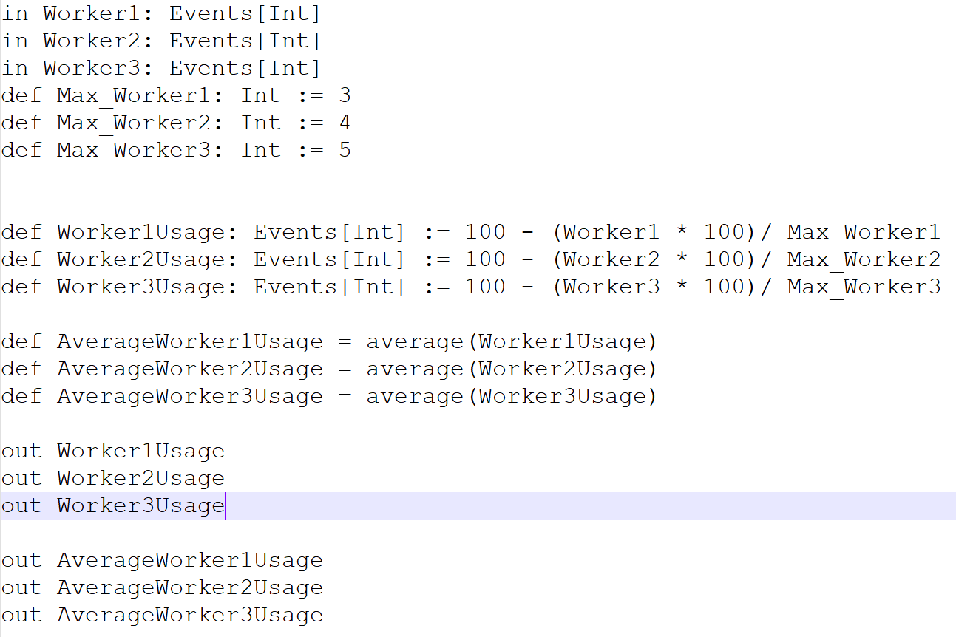
Tool Support
Eclipse plugin
Feature
model
Feature
configuration
TeSSLa
Specification
Simulation
Traces
TeSSLa
Std lib
FeatureIDE
TeSSLa
Export
TeSSLa
PN lib
Composer
CPN Tools
Titan
«uses»
Statistics
RuntimeVerification
Petrinets
Sirius Editor
Structural
Analysis
Invariants
«uses»
Sat4j
«uses»
150% Petri net
model with PCs
JaCoP

Slide 75
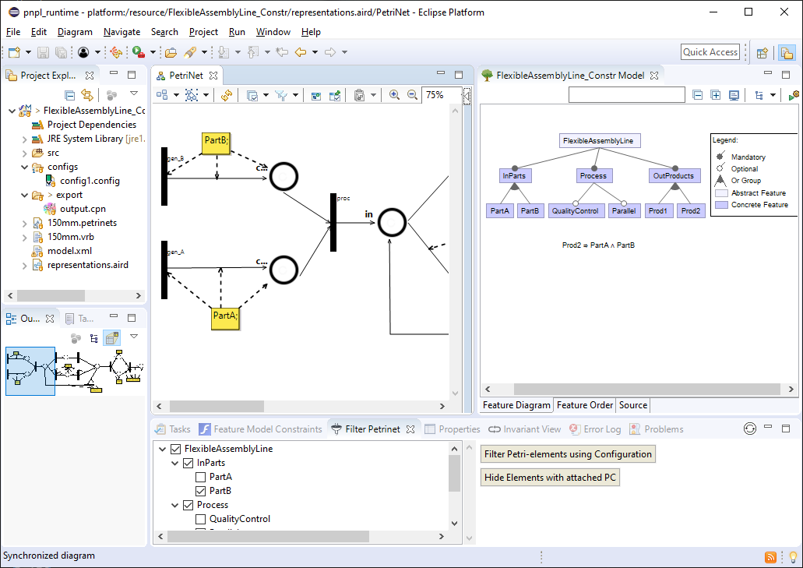
Tool Support
Eclipse plugin

Slide 76
Tool Support
Example
PartB
Prod1
gen_{B}
cnv_{B}
out₁
cnv₁
inc₁
prod₁
Prod1∧Prod2
in
ctrl
prod
pack
out₂
cnv₂
inc₂
proc
assembly
gen_{A}
cnv_{A}
fix
Parallel
prod₂
PartA
Prod2
QualityControl

Slide 77
Tool Support
Example
Legend
FlexibleAssemblyLine
mandatory
optional
InParts
Process
OutProducts
alternative
(exactly one)
or
(at least one)
PartA
PartB
QualityControl
Parallel
Prod1
Prod2
FM=⟨{FlexibleAssemblyLine, InParts, Process, OutProducts, PartA, PartB, QualityControl, …},
FlexibleAssemblyLine∧InParts∧Process∧OutProducts∧(PartA∨PartB)∧(Prod1∨Prod2)⟩

Slide 78
Tool Support
Example

Slide 79
Tool Support
Example

Slide 80
Tool Support

Slide 81
Tool Support
Example

Slide 82
Tool Support
Example

Slide 83
Tool Support

Slide 84
Tool Support
Example

Slide 85
Index
Motivation
Basic Concepts
Petri Net Product Lines
Structural Analysis & Runtime Verification of Petri Net Product Lines
Tool Support
Conclusions and Further Work

Slide 86
Conclusions and Further Work
Conclusions
Notion of Petri net product line
Analysis of structural properties at the product line level
Lifting techniques
Constraint Problem
Analysis of behavioural properties
Based on Coloured Petri Nets
Simulation and runtime monitoring with TeSSLa
Tool supporting PNPL
Notes:
To improve the efficiency of their analysis, we do not examine each derivable Petri net in $Prod(PNL)$ separately.
Instead, we work at the product line level by analysing the
PCs in the 150\% Petri net to determine if a particular element (place, transition or arc) is in $Prod(PNL)$. For this purpose, first we lift the definition of the MG property to the product line level. A PNPL is a MG if all its derivable nets are MGs.

Slide 87
Conclusions and Further Work
So far
Include notion of time
Simulation based on CPNTool
Integration with TeSSLA for the runtime verification of the traces
Further Work
Support more types of static analysis techniques
Develop a domain-specific language to express such analysis
Notes:
To improve the efficiency of their analysis, we do not examine each derivable Petri net in $Prod(PNL)$ separately.
Instead, we work at the product line level by analysing the
PCs in the 150\% Petri net to determine if a particular element (place, transition or arc) is in $Prod(PNL)$. For this purpose, first we lift the definition of the MG property to the product line level. A PNPL is a MG if all its derivable nets are MGs.

